Slide 1
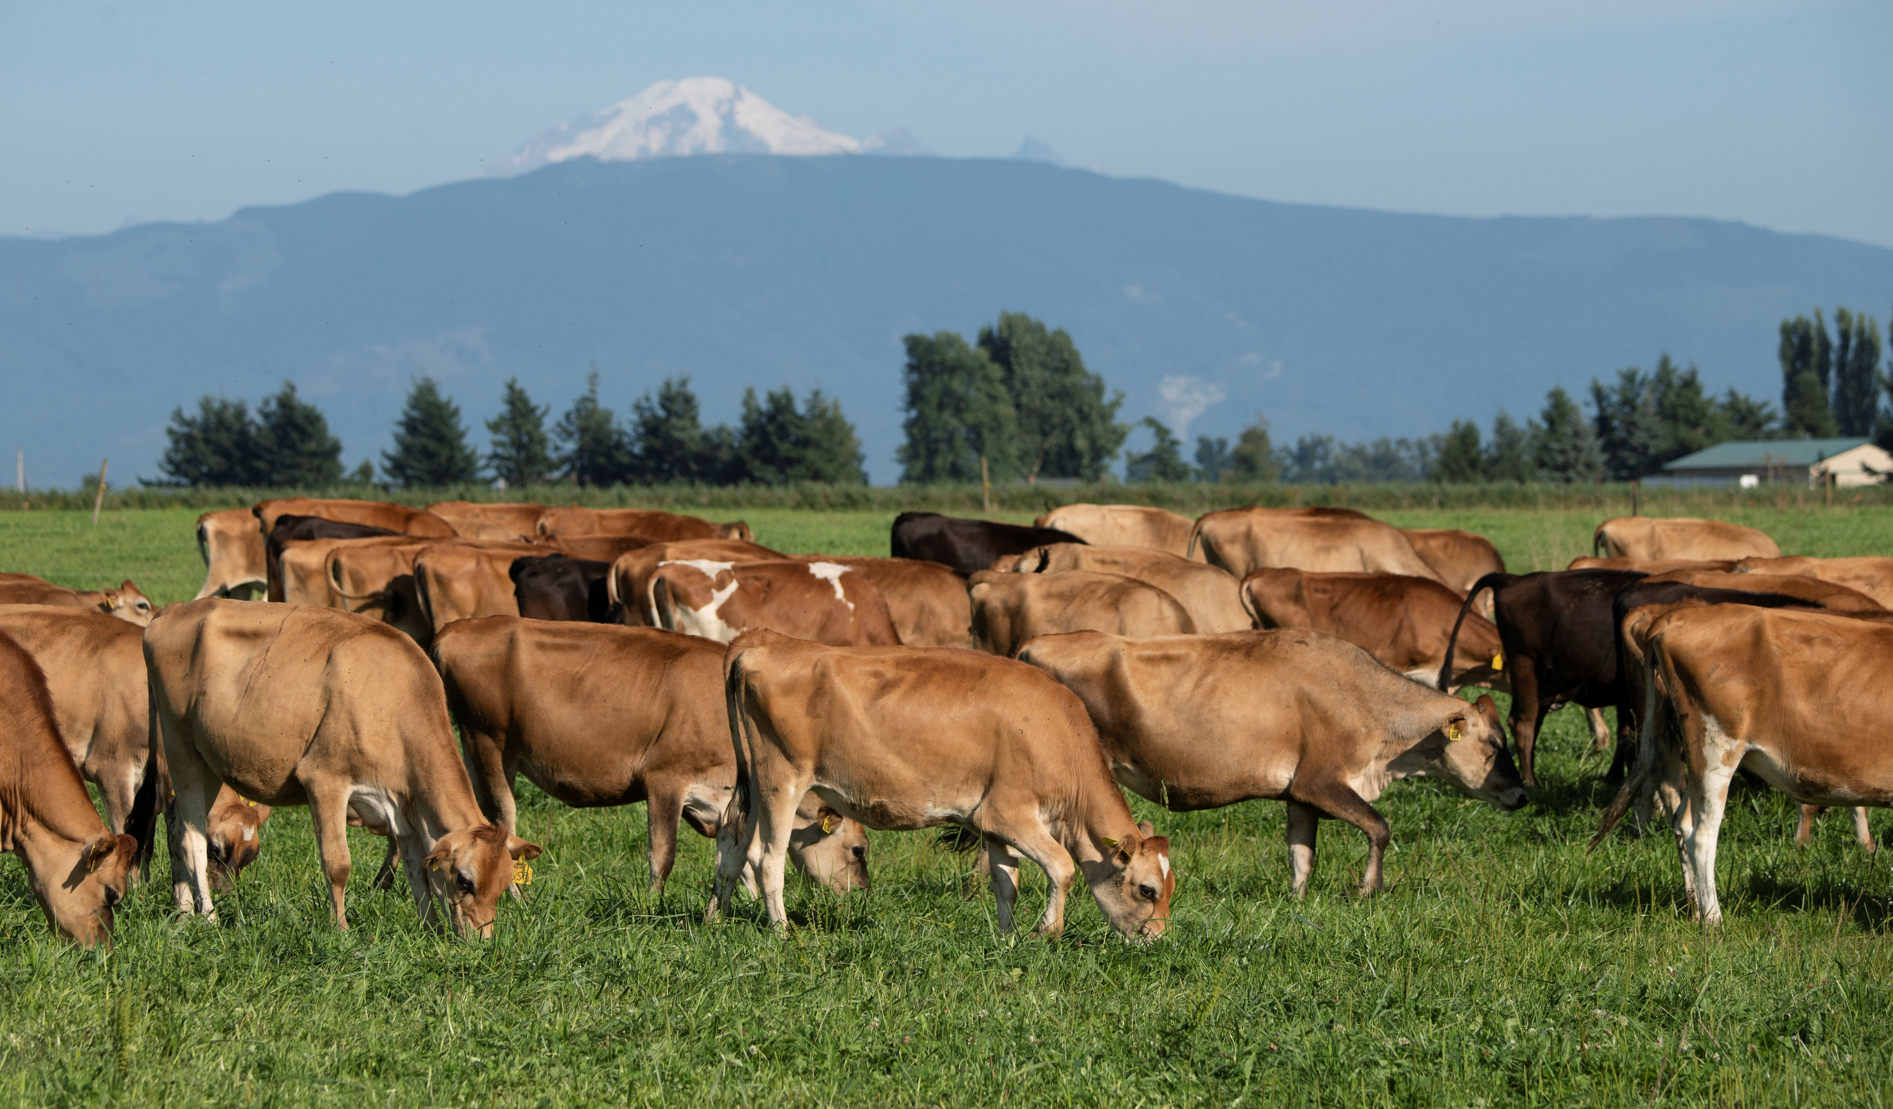
How do you talk about food price inflation?
Seth Meyer
Office of the Chief Economist
USDA

Slide 2
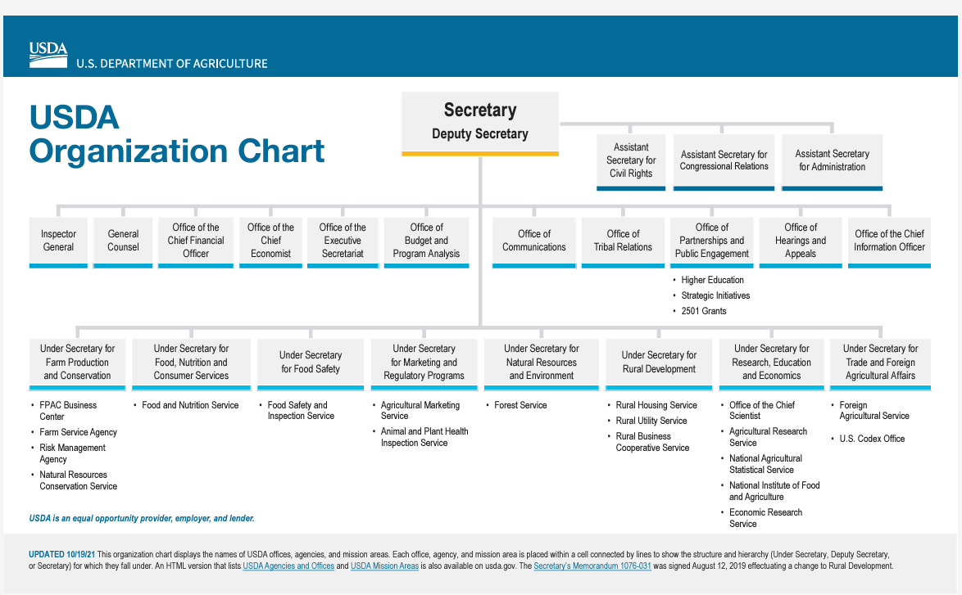
The Office of the Chief Economist is Non-political

Slide 3
The Office of the Chief Economist is Non-political
✓
✓
✓
✓

Slide 4
The Office of the Chief Economist has wide-ranging responsibilities:
OCE Immediate Office (IO)
Economic and policy analysis
Advise the Secretary on economic impacts of market developments, program changes, legislative proposals, trade initiatives, and agricultural labor issues
USDA sustainable development coordinator
USDA food loss and waste coordinator
World Agricultural Outlook Board (WAOB)
Joint Ag Weather Facility (JAWF)

Slide 5
The Office of the Chief Economist has wide-ranging responsibilities (cont.):
Office of Pest Management Policy (OPMP)
USDA’s Biotech Coordinator
Office of Energy and Environmental Policy (OEEP)
Climate Change Program Office
Office of Energy and New Uses
Office of Environmental Markets
Office of Risk Assessment and Cost-Benefit Analysis (ORACBA)

Slide 6

Food is Different
A New BMW or your TikTok account?
Basic Food (not all food?)
Maslow’s Hierarchy Of Needs

Slide 7
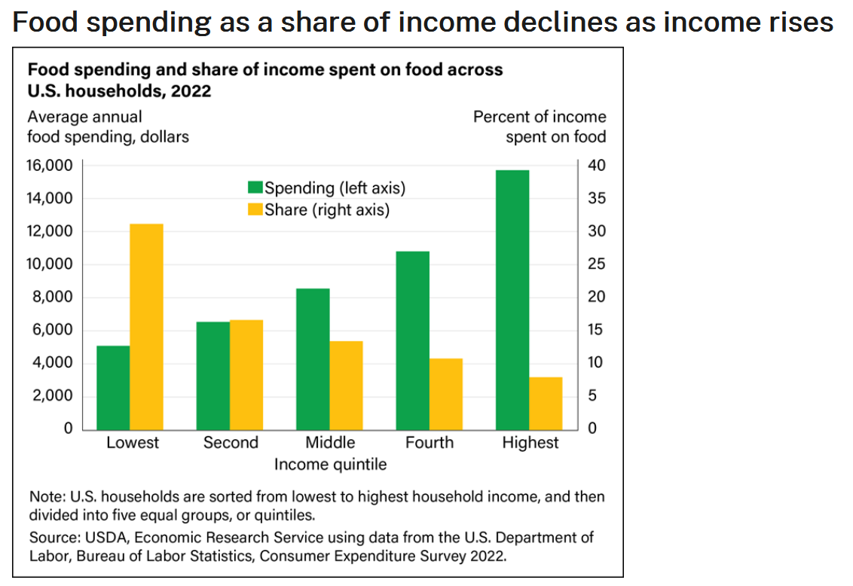

Slide 8
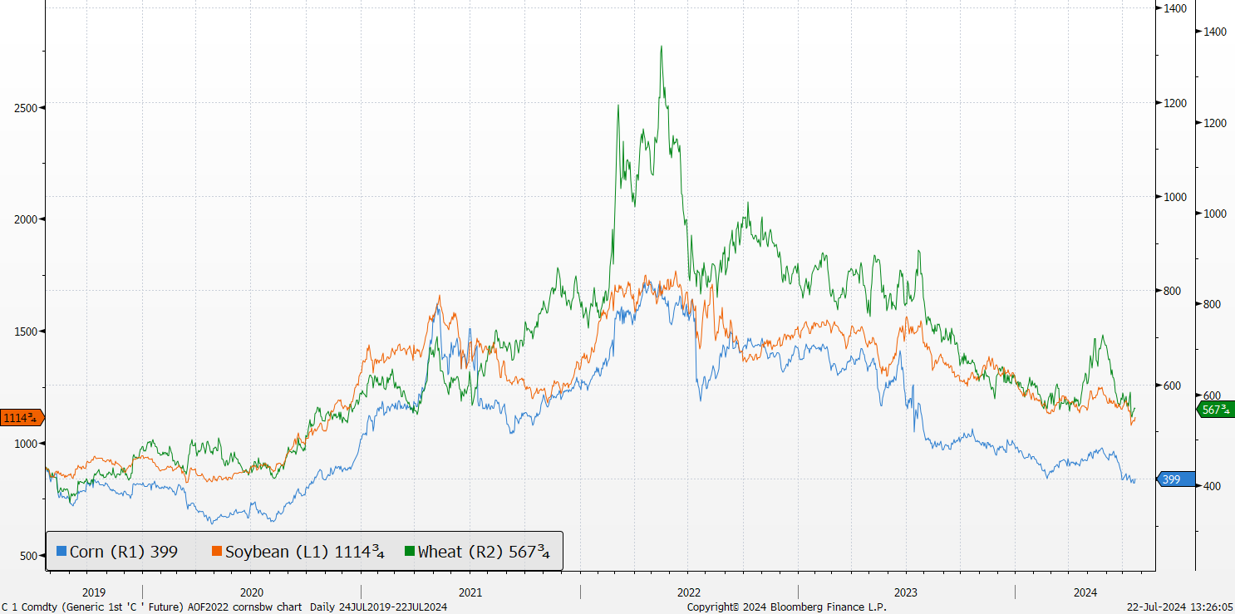
Corn, Soybean, and Wheat Futures nearby futures in cents per bushel
8
Wheat (HRW)
Soybeans
Corn

Slide 9
Asian rice prices rise following India export restrictions
9
Timeline of Government of India Rice Restrictions
Sept 2022, ban on broken rice exports and 20 percent export duty on non-Basmati rice except parboiled
July 2023, export ban on non-Basmati white rice
Aug 2023, 20 percent export duty on parboiled rice and minimum export price for Basmati rice
India exported 39 percent of global rice exports i marketing year 2021/22 (22 million tons):
34 percent parboiled rice
25 percent non-parboiled white rice
20 percent broken rice
19 percent Basmati rice
2 percent paddy and brown rice

Slide 10
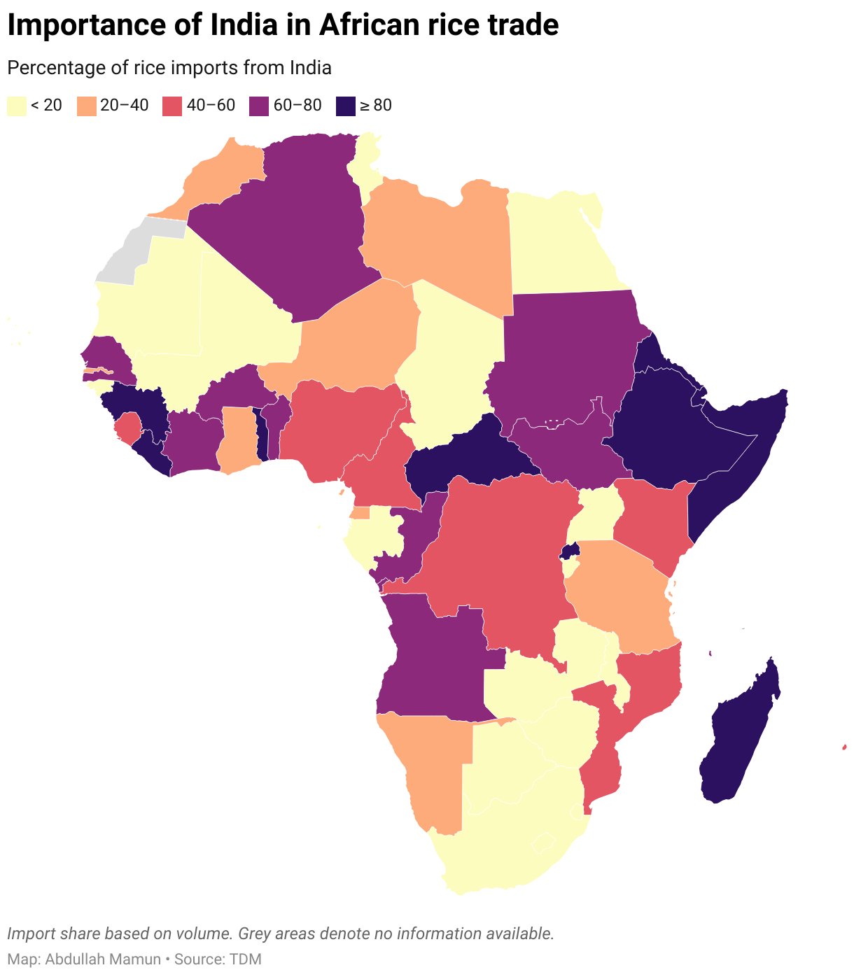
Asian rice prices rise following India export restrictions
10
From Joe Glauber @ IFPRI

Slide 11
Trade Weighted Exchange Rate: U.S. Ag Exports to the World

Slide 12
Farmgate prices are far more volatile than food Farmgate prices vs food retail prices, year over year % changes.

Slide 13
Supply Chain Disruptions, Rising Commodity Prices, General CPI
CPI
PPI
Food CPI Drivers: supply chain adjustments and rising commodity prices
Food CPI Drivers: Supply Chain and Food at Home
Food CPI Drivers:
War?
Wage inflation?
Transit and packaging?
Data: BLS
Notes:
Updated Jan 21, 2022 with Dec data

Slide 14
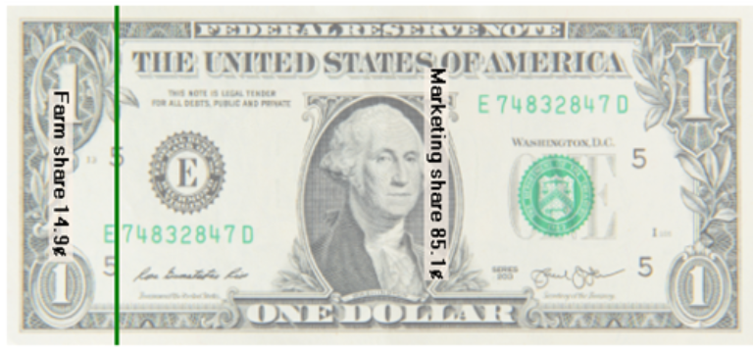
The Food Dollar Economic Research Service
Farm Share 14.9¢
Marketing Share 85.1¢

Slide 15
Farm Value Share varies significantly by commodity

Slide 16
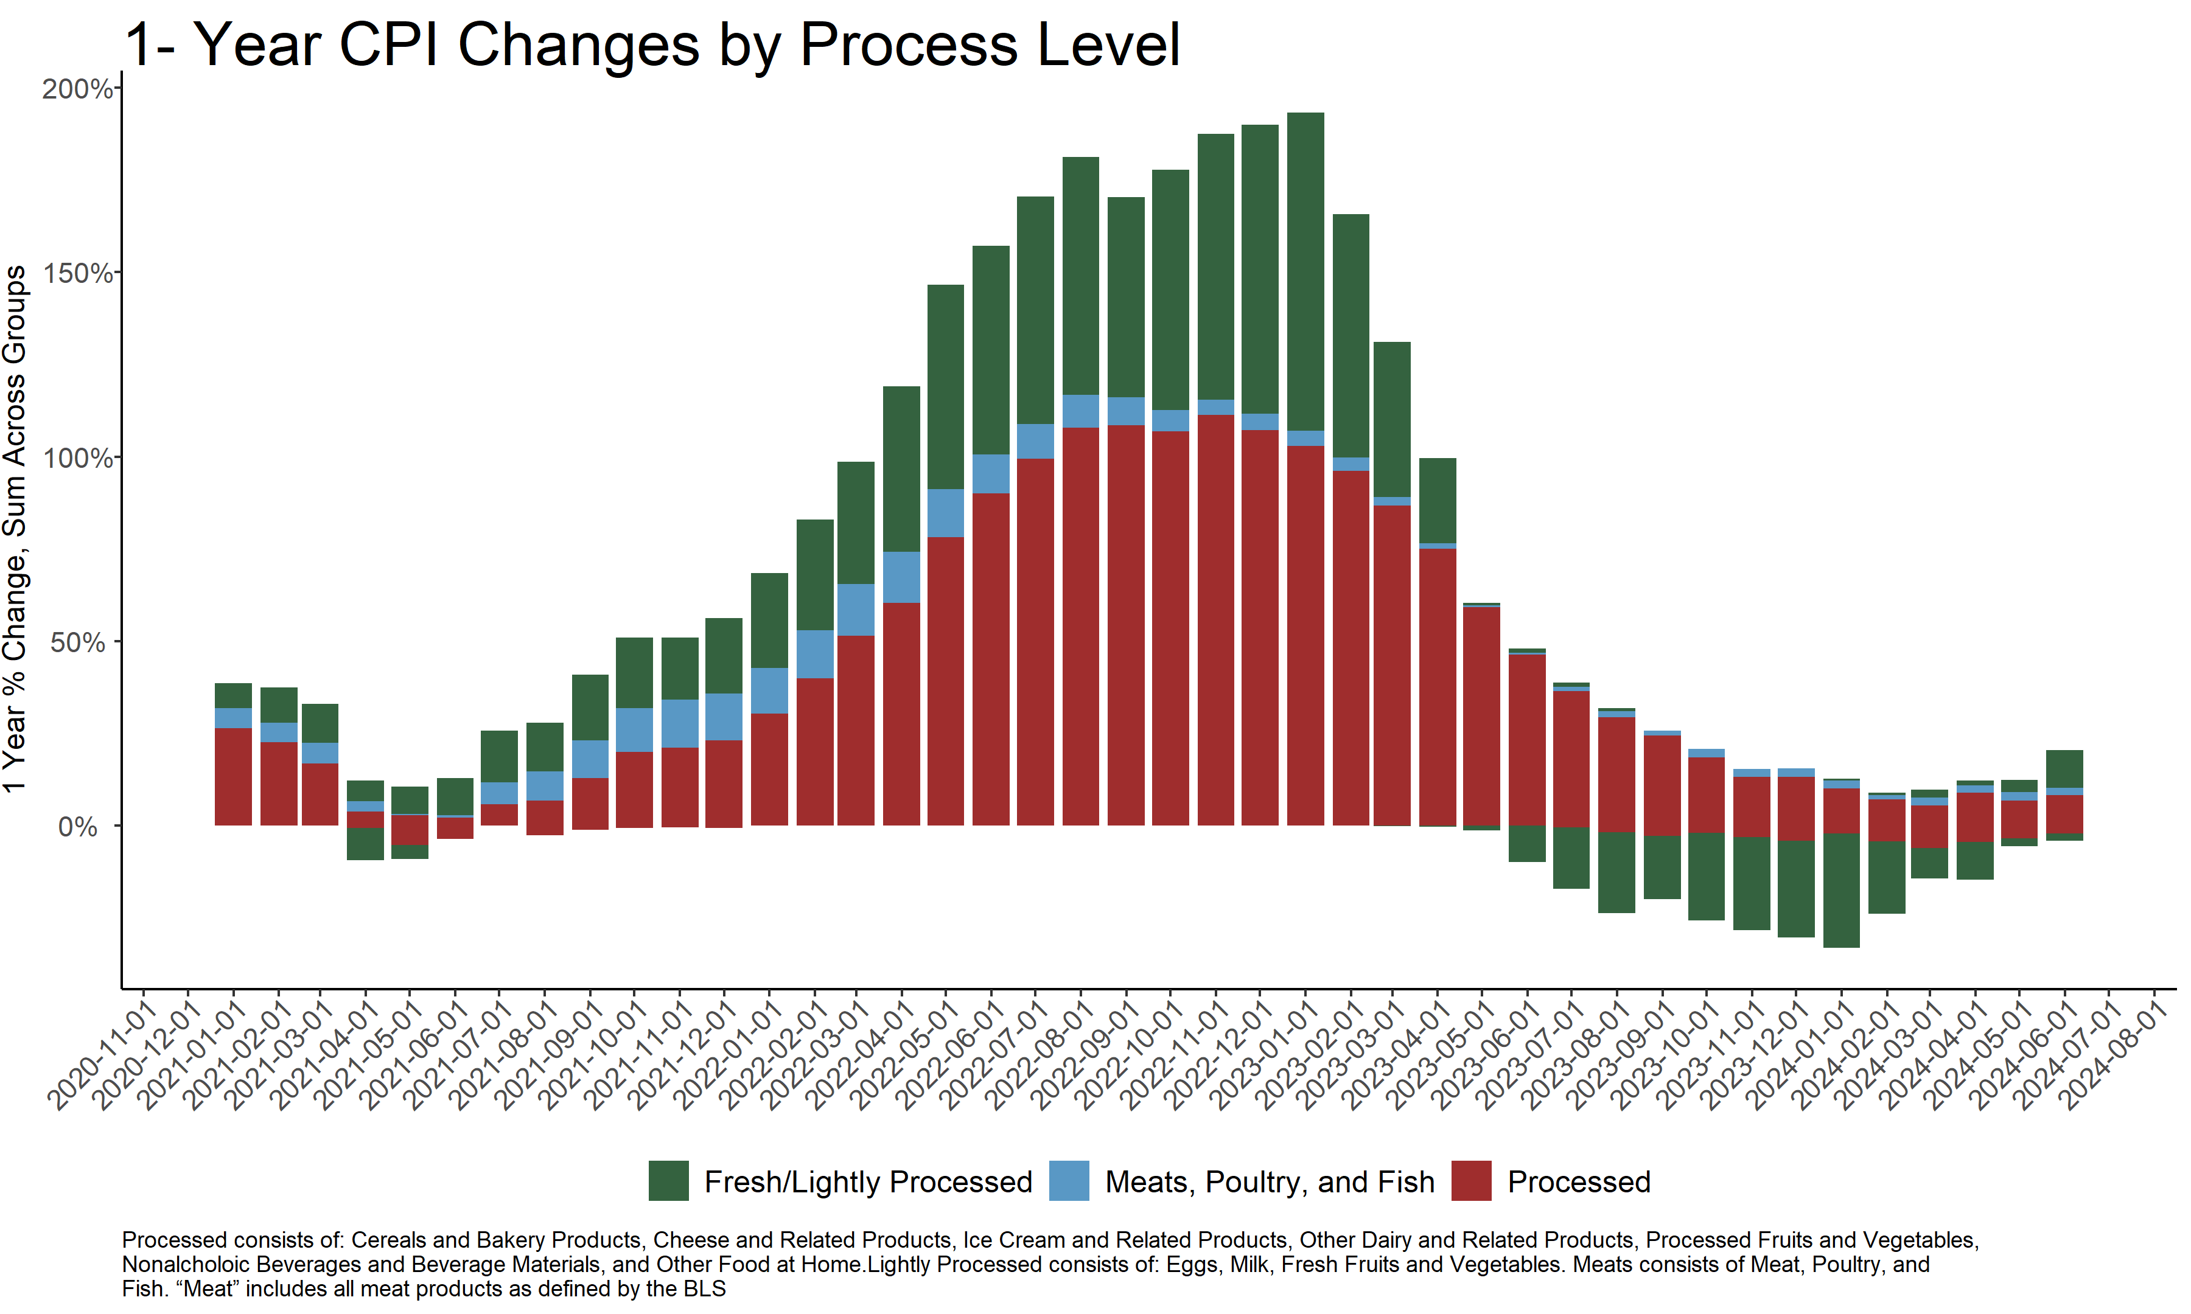

Slide 17
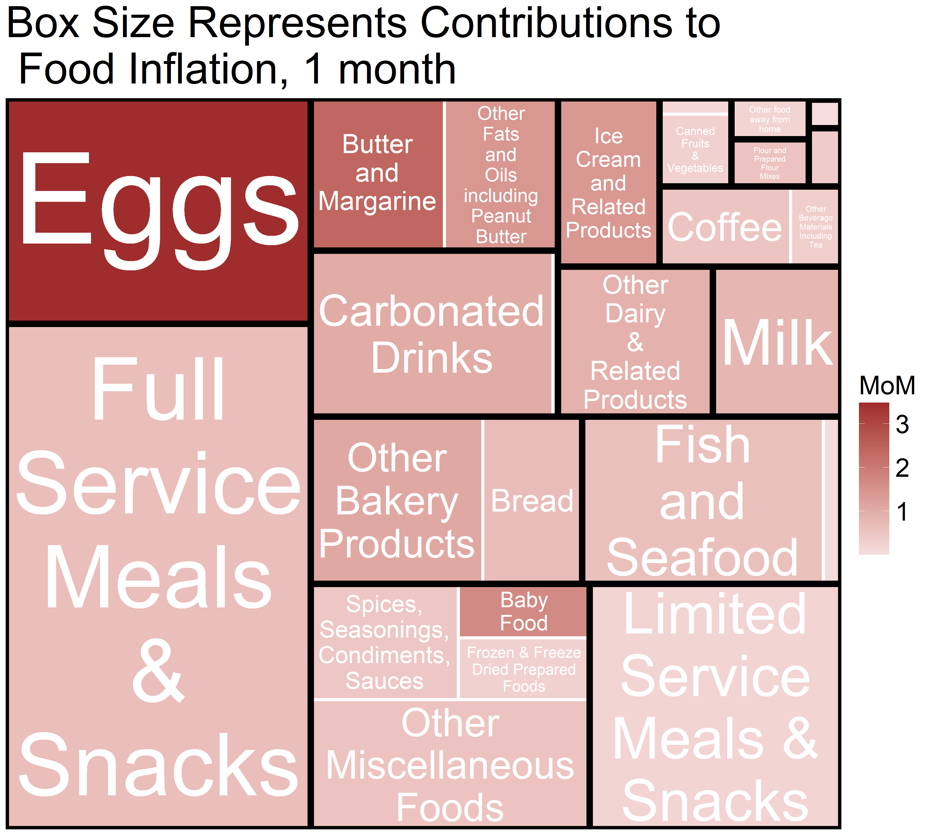

Slide 18
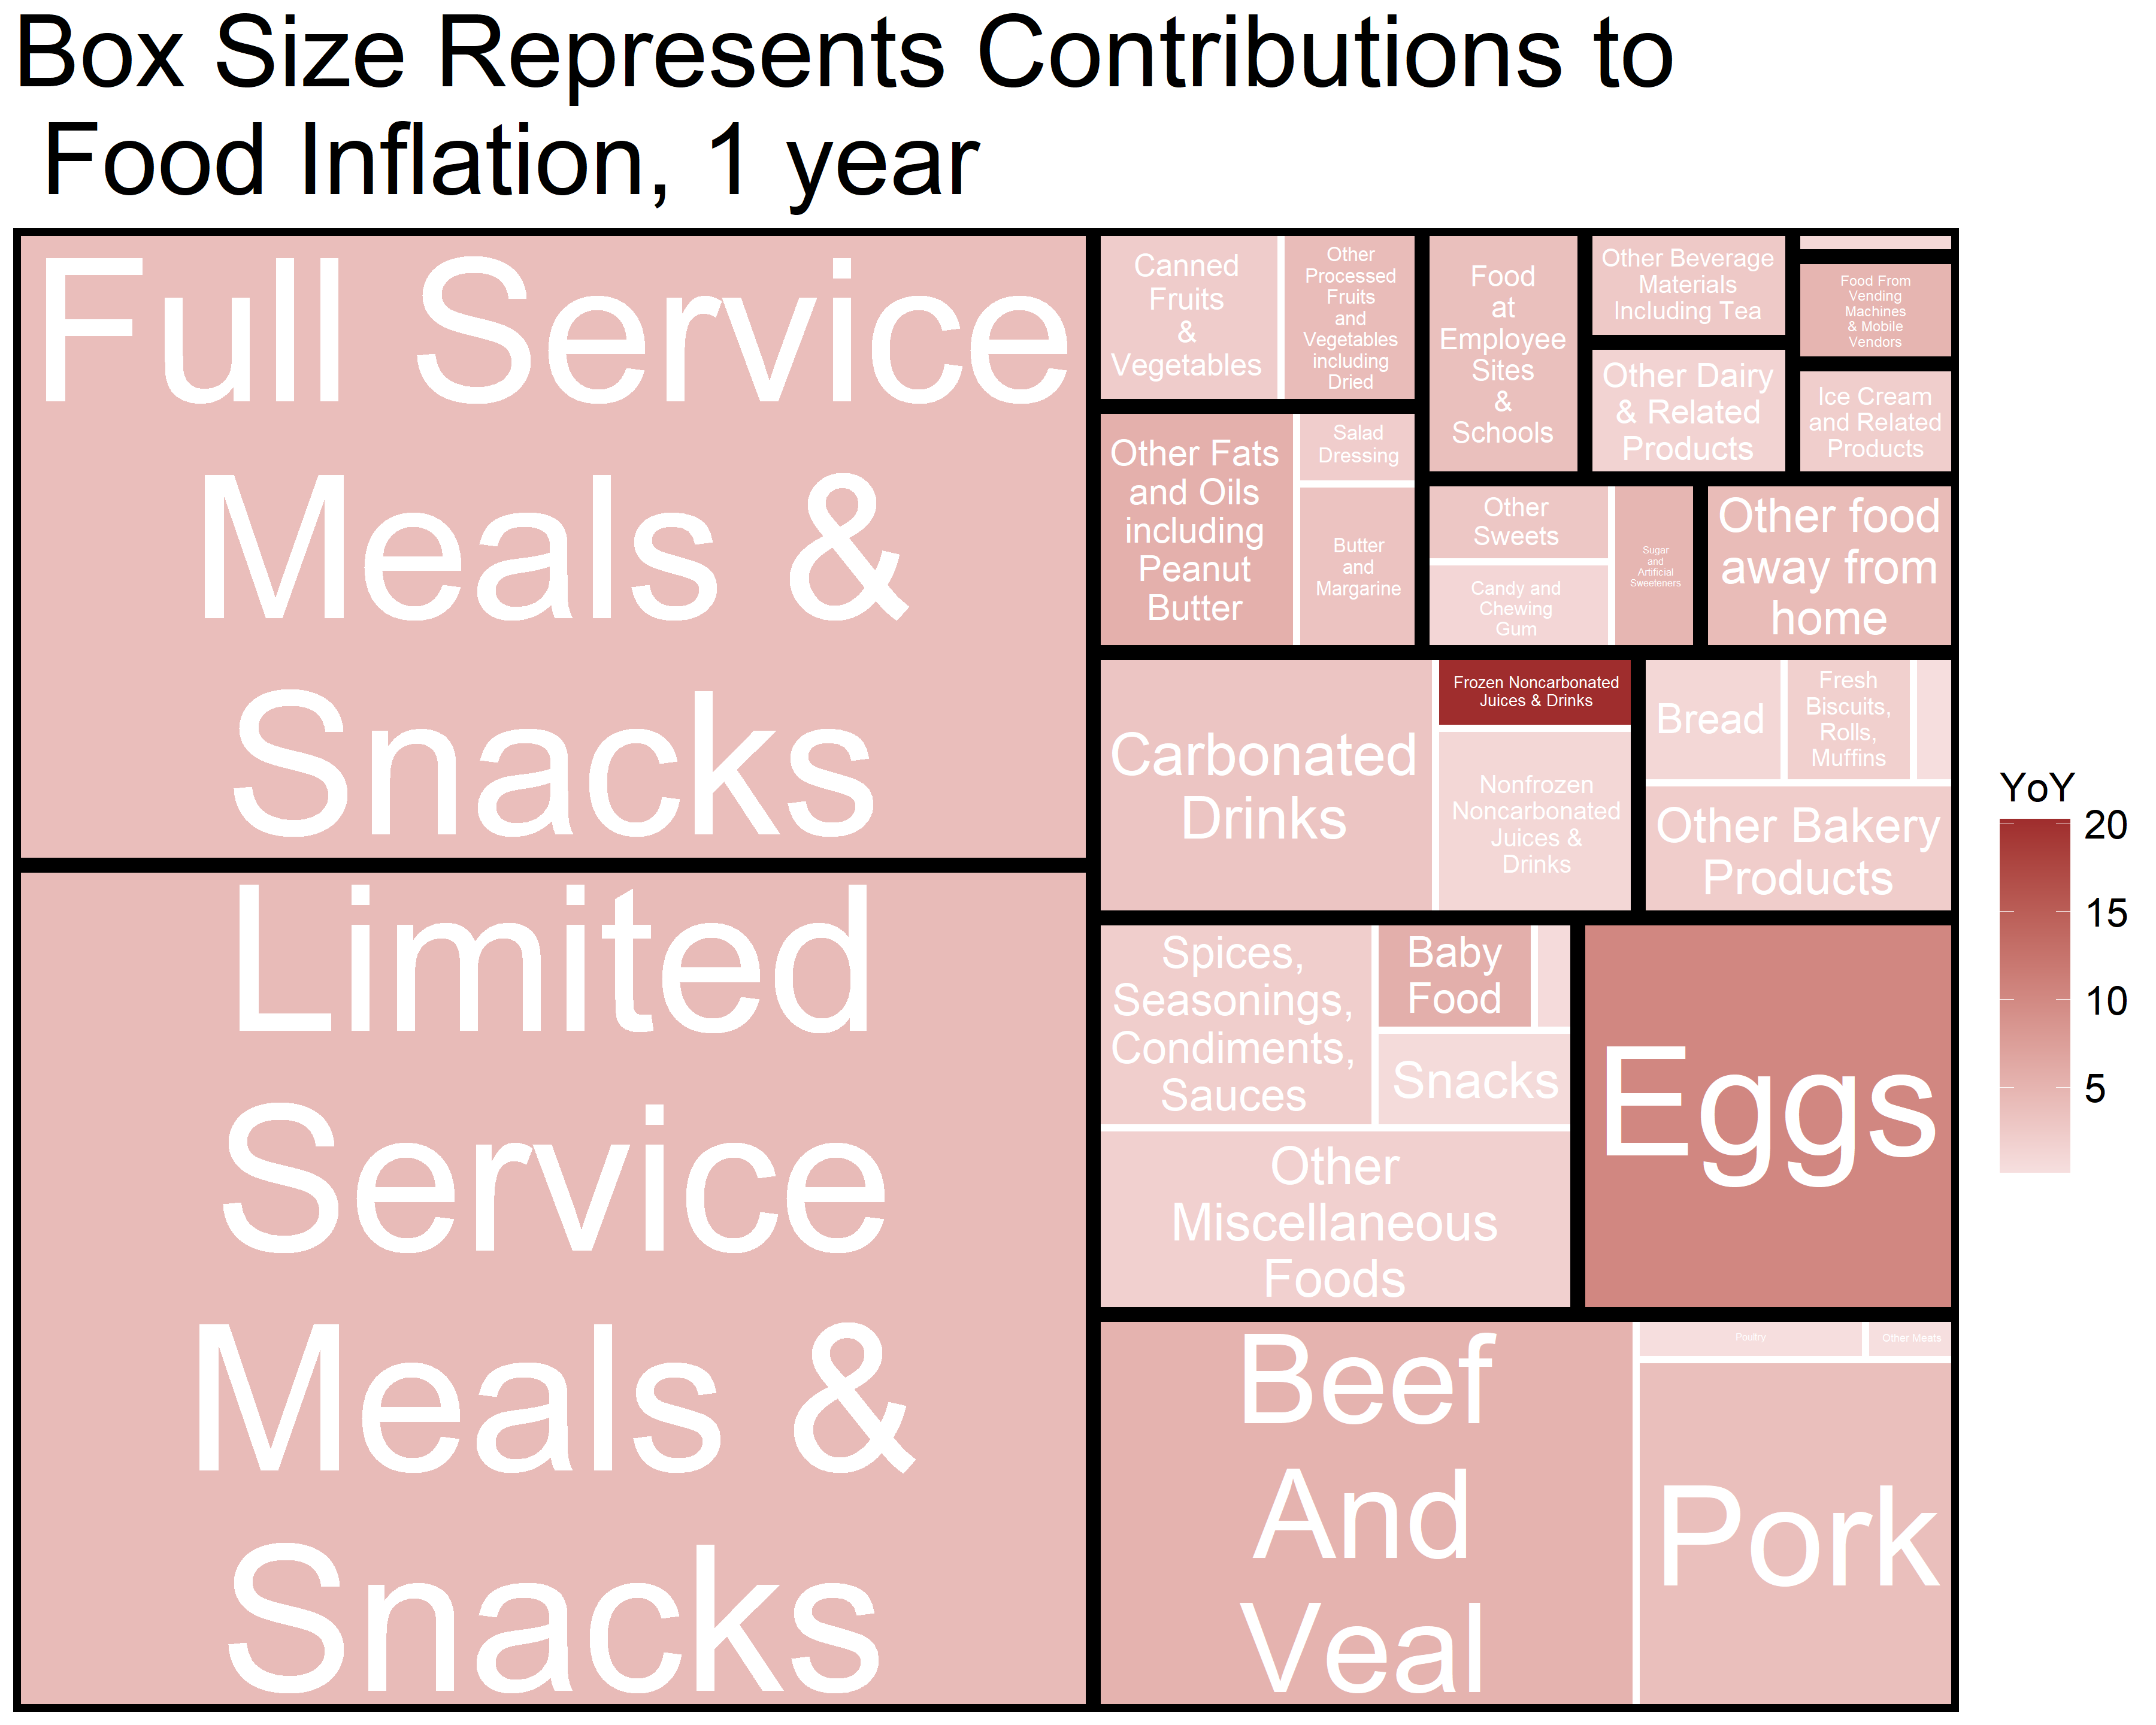

Slide 19
Understanding Seasonality, Thanksgiving Turkey National Average Weekly Prices of 10-15 lb Whole Bird Turkeys, $/lbs Source: USDA Estimates using IRI data

Slide 20
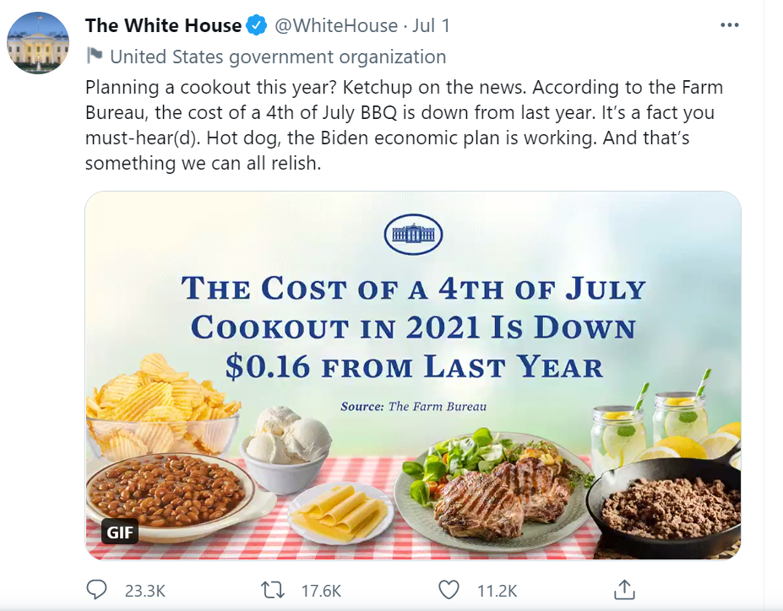
The difficulty in talking about food price inflation in the middle of a pandemic
Food price inflation tweet gets ‘ratioed’
-
+

Slide 21
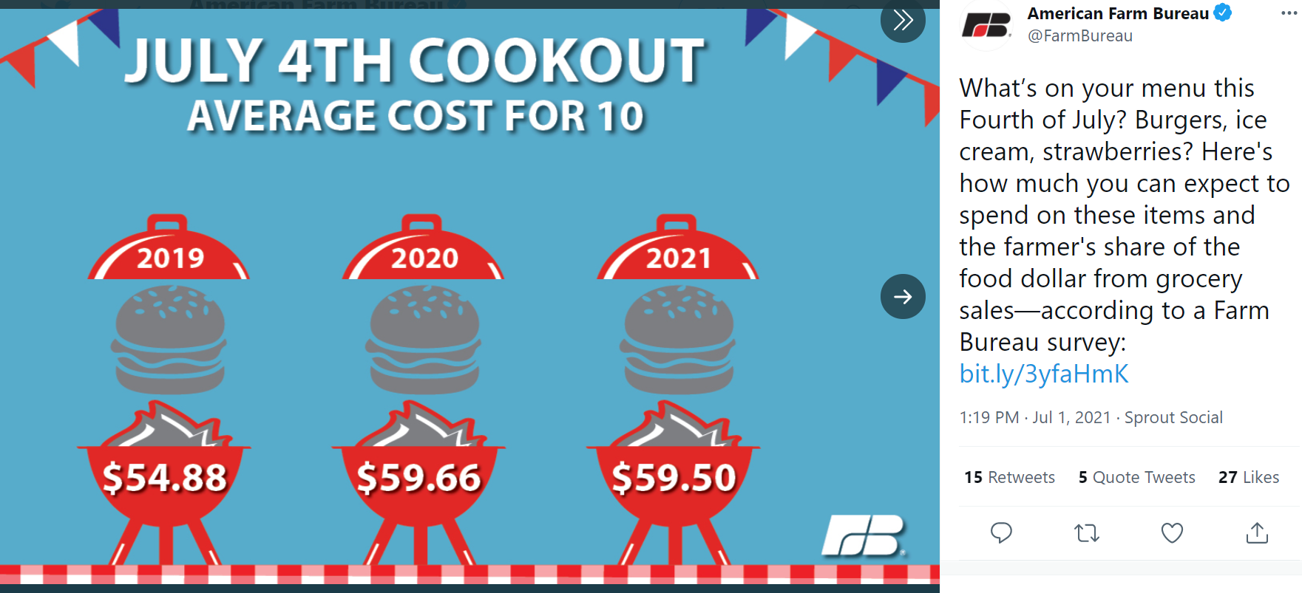
….the base effects become incredibly important and ‘point in time’ comparisons less meaningful

Slide 22
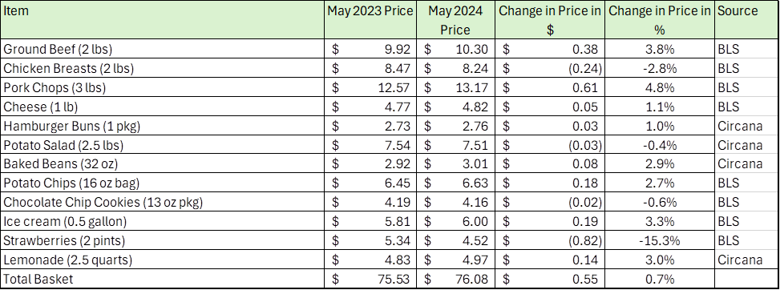
USDA Calculation of the July 4th, 2024 Picnic
Jessica Xu, OCE

Slide 23
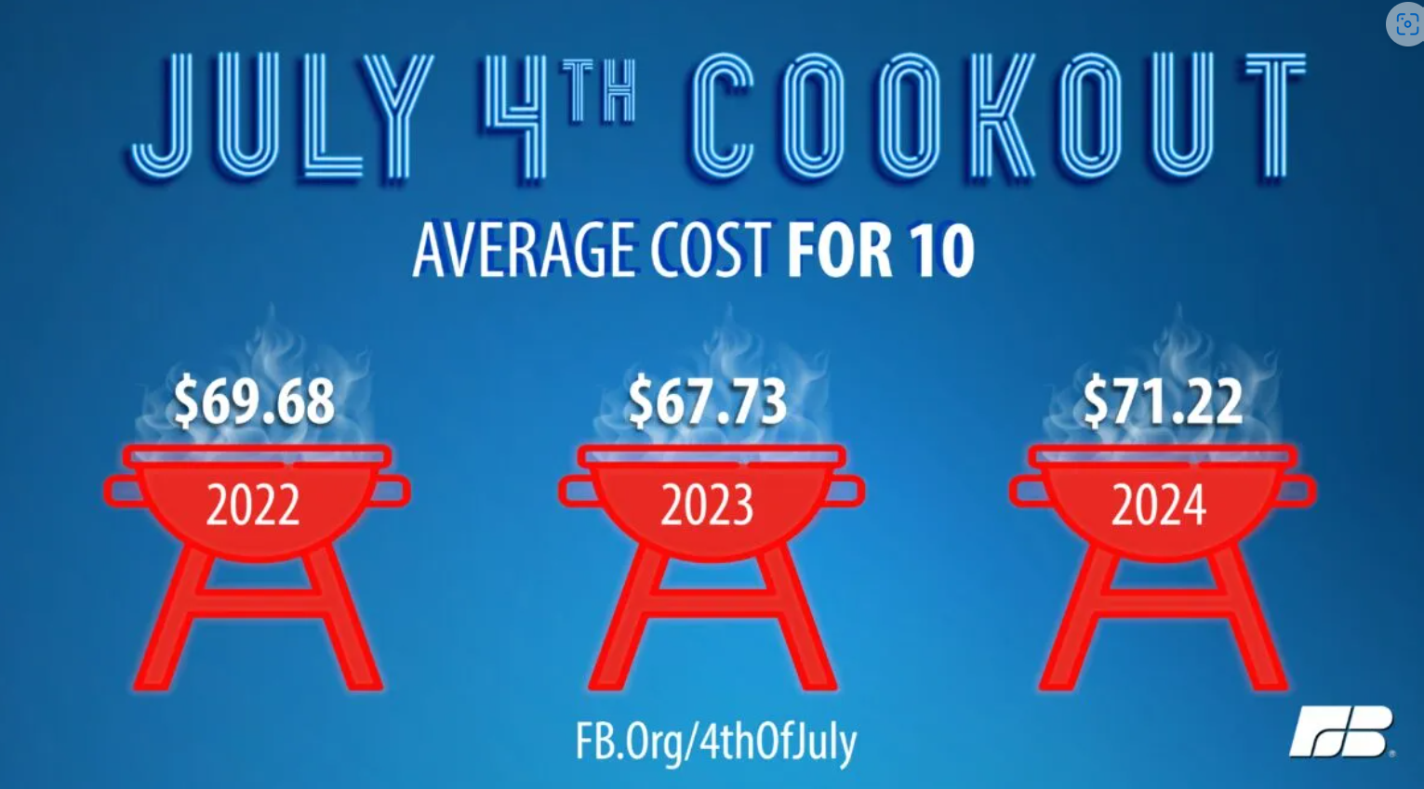
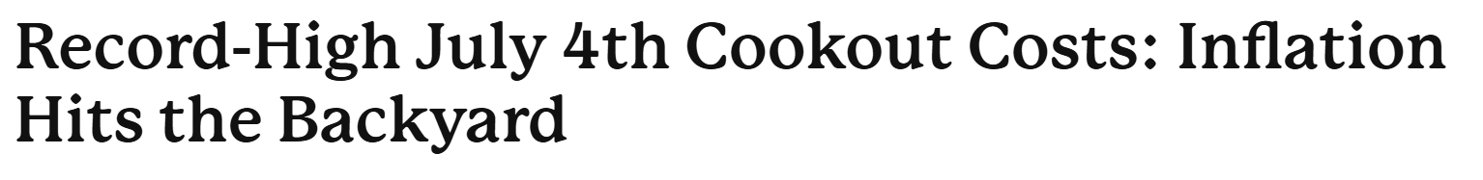

Slide 24
Proposition 12 Average Price Premium
Table 2: Proposition 12 Average Price Premium
Supply Chain Level | Data Source | ($/lb) | Average Percentage Premium
Wholesale Swine | USDA AMS Animal Confinement Legislation Non-Carcass Merit Premium | $0.053/lb. (carcass weight equivalent) | $11.34/head or ≈6% (assuming an average carcass weight of 213 lbs ¹)
Wholesale | USDA AMS LMR Prop. 12 Data ² | $0.38/lb. | 21%
Retail | Circana Scanner Data | $0.60/lb. | 19%
¹ There are no associated weights reported with the non-carcass merit premiums, this is an estimate that is calculated using the 2023 average carcass weight from all slaughter hog data.
² Not publicly available data

Slide 25
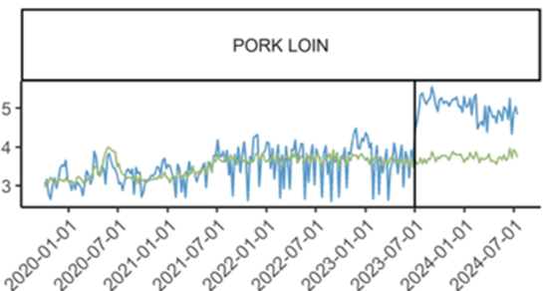
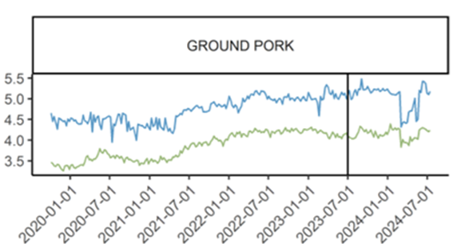
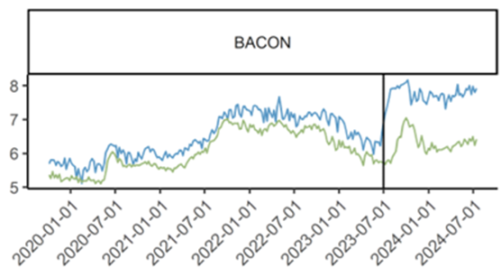
Pork Cuts Retail Pricing
--- California
--- Rest of the US

Slide 26
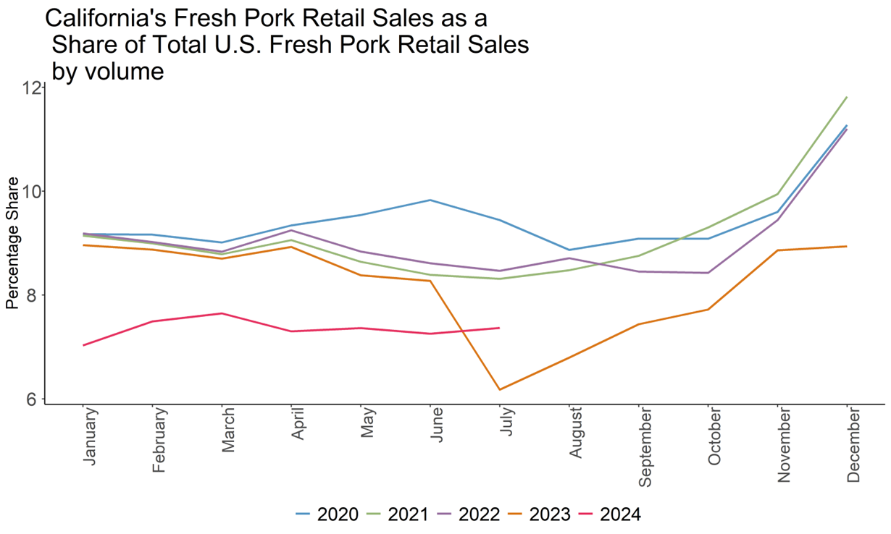

Slide 27
USDA Food Price Outlook forecasts and annual average changes in BLS Consumer Price Indexes, 2021 through 2024
Consumer Price Index item | Annual 2021 | Annual 2022 | Annual 2023 | 20-year historical average (2004–2023) | USDA Forecast Prediction Interval 2024
 | Percent change | Percent change | Percent change | Percent change | Percent change
 |  |  |  |  | Lower | Mid | Upper
All food | 3.9 | 9.9 | 5.8 | 3.0 | 1.2 | 2.2 | 3.2
Food away from home | 4.5 | 7.7 | 7.1 | 3.4 | 3.6 | 4.2 | 4.8
Food at home | 3.5 | 11.4 | 5.0 | 2.7 | -0.4 | 1.0 | 2.5
Meats, poultry, and fish | 6.8 | 9.6 | 2.0 | 3.3 | -0.5 | 1.8 | 4.3
Meats | 7.7 | 8.2 | 2.1 | 3.4 | -0.8 | 2.3 | 5.5
Beef and veal | 9.3 | 5.3 | 3.6 | 4.3 | -0.2 | 3.9 | 8.4
Pork | 8.6 | 8.7 | -1.2 | 2.5 | -2.6 | 1.1 | 4.7
Other meats | 2.9 | 14.2 | 4.5 | 2.8 | -0.7 | 1.1 | 3.0
Poultry | 5.1 | 14.6 | 3.1 | 3.0 | -0.8 | 1.1 | 3.0
Fish and seafood | 5.4 | 9.1 | 0.3 | 3.2 | -2.9 | -1.1 | 0.7
Eggs | 4.5 | 32.2 | 1.4 | 4.1 | -7.6 | 0.1 | 9.5
Dairy products | 1.4 | 12.0 | 4.0 | 2.5 | -2.9 | -1.1 | 0.8
Fats and oils | 4.6 | 18.5 | 9.0 | 3.6 | 0.3 | 2.8 | 5.5
Fruits and vegetables | 3.2 | 8.5 | 2.5 | 2.2 | -0.8 | 0.9 | 2.6
Fresh fruits and vegetables | 3.3 | 7.5 | 0.8 | 2.0 | -1.4 | 0.7 | 2.8
Fresh fruits | 5.5 | 7.9 | 0.7 | 2.0 | -1.9 | 0.5 | 3.1
Fresh vegetables | 1.1 | 7.0 | 0.9 | 2.1 | -1.7 | 1.0 | 3.8
Processed fruits and vegetables | 2.9 | 12.0 | 8.0 | 2.9 | 0.4 | 2.6 | 4.9
Sugar and sweets | 3.0 | 10.4 | 8.7 | 2.8 | 2.0 | 3.8 | 5.6
Cereals and bakery products | 2.3 | 13.0 | 8.4 | 2.9 | -0.7 | 0.9 | 2.4
Nonalcoholic beverages | 2.8 | 11.0 | 7.0 | 2.2 | 1.0 | 2.5 | 4.2
Other foods | 2.2 | 12.7 | 6.6 | 2.4 | -0.8 | 0.8 | 2.5
Note: The Food Price Outlook forecasts the annual average percentage change in prices. Prediction intervals represent a 95-percent confidence level.
The most recent forecast was published on June 25, 2024. The next forecast will be published on July 25, 2024.
Source: U.S. Bureau of Labor Statistics Consumer Price Indexes (not seasonally adjusted) and forecasts by USDA, Economic Research Service.

Slide 28
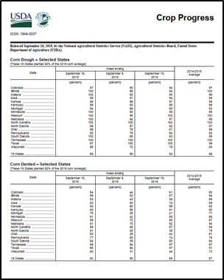
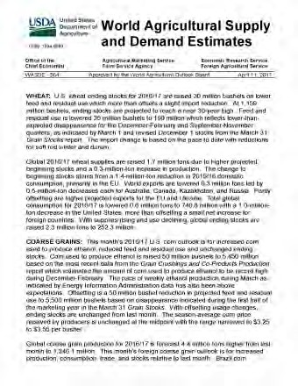
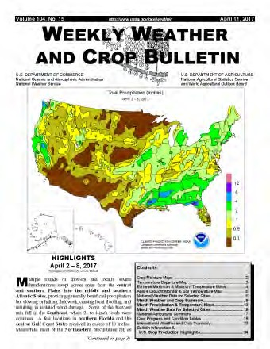
Questions? Seth.Meyer@usda.gov
2024 Agricultural
Outlook
Seth Meyer
Chief Economist, USDA

